Slide 1
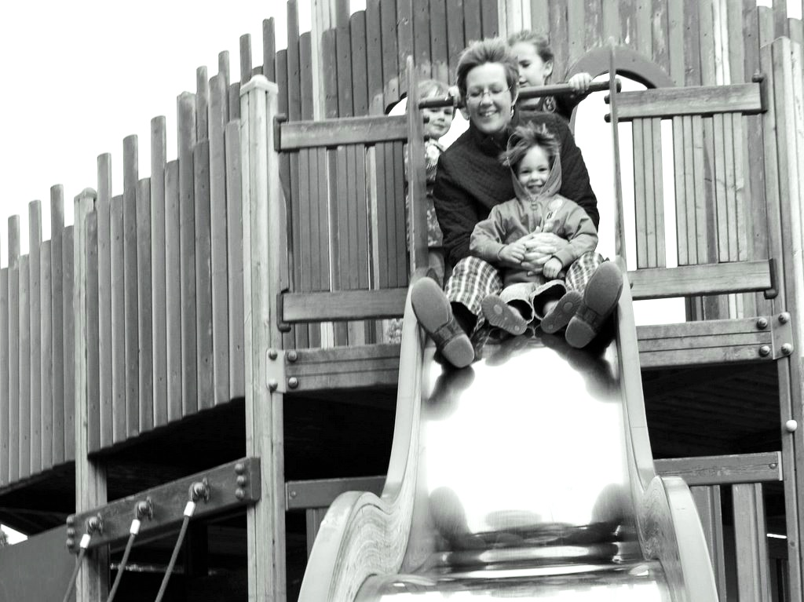
Joint Action
and the
Emergence
of Mindreading
s.butterfill@warwick.ac.uk

Slide 2
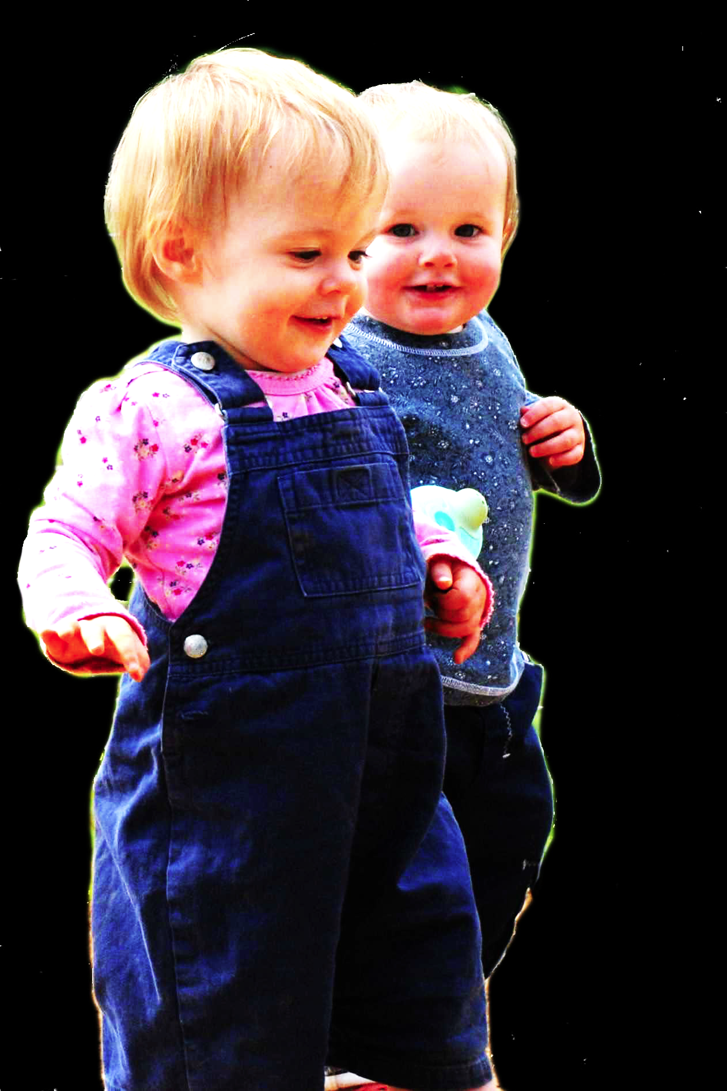
challenge
Explain the emergence, in evolution or development, of sophisticated forms of theory of mind cognition.

Slide 3
challenge
Explain the emergence, in evolution or development, of sophisticated forms of theory of mind cognition.

Slide 4
challenge
Explain the emergence, in evolution or development, of sophisticated forms of theory of mind cognition.

Slide 5


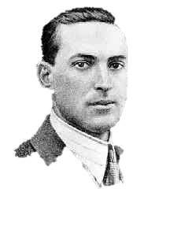


challenge
Explain the emergence, in evolution or development, of sophisticated forms of theory of mind cognition.
“the unique aspects of human cognition ... were driven by, or even constituted by, social co-operation”
(Moll & Tomasello 2007)
“perception, action, and cognition are grounded in social interaction”
(Sebanz & Knoblich 2008)

Slide 6
challenge
Explain the emergence, in evolution or development, of sophisticated forms of theory of mind cognition.
conjecture
The existence of abilities to engage in joint action partially explains how sophisticated forms of theory of mind cognition emerge in evolution or development (or both)

Slide 7
challenge
Explain the emergence, in evolution or development, of sophisticated forms of theory of mind cognition.
conjecture
The existence of abilities to engage in joint action partially explains how sophisticated forms of theory of mind cognition emerge in evolution or development (or both)

Slide 8
tidying up the toys together
(Behne et al 2005)
cooperatively pulling handles in sequence to make a dog-puppet sing
(Brownell et al 2006)
bouncing a cube on a large trampoline together
(Warneken, Chen & Tomasello 2006)
pretending to row a boat together

Slide 9
painting a house together
(Bratman 1992)
lifting a heavy sofa together
(Velleman 1997)
preparing a hollandaise sauce together
(Searle 1990)
going to Chicago together
(Kutz 2000)
walking together
(Gilbert 1990)
tidying up the toys together
(Behne et al 2005)
cooperatively pulling handles in sequence to make a dog-puppet sing
(Brownell et al 2006)
bouncing a cube on a large trampoline together
(Warneken, Chen & Tomasello 2006)
pretending to row a boat together

Slide 10
challenge
Explain the emergence, in evolution or development, of sophisticated forms of theory of mind cognition.
conjecture
The existence of abilities to engage in joint action partially explains how sophisticated forms of theory of mind cognition emerge in evolution or development (or both)

Slide 11
challenge
Explain the emergence, in evolution or development, of sophisticated forms of theory of mind cognition.
conjecture
The existence of abilities to engage in joint action partially explains how sophisticated forms of theory of mind cognition emerge in evolution or development (or both)
first objection
Sophisticated forms of theory of mind cognition emerge before joint action

Slide 12
Theory of mind abilities are widespread

Slide 13
Theory of mind abilities are widespread
18-month-olds point to inform, and predict actions based on false beliefs
(Liszkowski et al 2006)
(Onishi & Baillargeon 2005; Southgate et al 2007)

Slide 14
Theory of mind abilities are widespread
18-month-olds point to inform, and predict actions based on false beliefs
Scrub-jays selectively re-cache their food in ways that deprive competitors of knowledge of its location
(Liszkowski et al 2006)
(Onishi & Baillargeon 2005; Southgate et al 2007)
(Clayton, Dally & Emery 2007)

Slide 15
Theory of mind abilities are widespread
18-month-olds point to inform, and predict actions based on false beliefs
Scrub-jays selectively re-cache their food in ways that deprive competitors of knowledge of its location
Chimpanzees conceal their approach from a competitor’s view, and act in ways that are optimal given what another has seen
(Liszkowski et al 2006)
(Onishi & Baillargeon 2005; Southgate et al 2007)
(Clayton, Dally & Emery 2007)
(Hare, Call & Tomasello 2006)
(Hare, Call & Tomasello 2001)

Slide 16
Theory of mind abilities are widespread
18-month-olds point to inform, and predict actions based on false beliefs
Scrub-jays selectively re-cache their food in ways that deprive competitors of knowledge of its location
Chimpanzees conceal their approach from a competitor’s view, and act in ways that are optimal given what another has seen
(Liszkowski et al 2006)
(Onishi & Baillargeon 2005; Southgate et al 2007)
(Clayton, Dally & Emery 2007)
(Hare, Call & Tomasello 2006)
(Hare, Call & Tomasello 2001)

Slide 17
Theory of mind abilities are widespread
18-month-olds point to inform, and predict actions based on false beliefs
Scrub-jays selectively re-cache their food in ways that deprive competitors of knowledge of its location
Chimpanzees conceal their approach from a competitor’s view, and act in ways that are optimal given what another has seen
(Liszkowski et al 2006)
(Onishi & Baillargeon 2005; Southgate et al 2007)
(Clayton, Dally & Emery 2007)
(Hare, Call & Tomasello 2006)
(Hare, Call & Tomasello 2001)

Slide 18
Theory of mind abilities are widespread
18-month-olds point to inform, and predict actions based on false beliefs
Scrub-jays selectively re-cache their food in ways that deprive competitors of knowledge of its location
Chimpanzees conceal their approach from a competitor’s view, and act in ways that are optimal given what another has seen
Representing perceptions, knowledge states and beliefs is hard

Slide 19
Theory of mind abilities are widespread
18-month-olds point to inform, and predict actions based on false beliefs
Scrub-jays selectively re-cache their food in ways that deprive competitors of knowledge of its location
Chimpanzees conceal their approach from a competitor’s view, and act in ways that are optimal given what another has seen
Representing perceptions, knowledge states and beliefs is hard, for it requires
(a) conceptual sophistication
- takes years to develop
- development tied to acquisition of executive function and language
- development facilitated by training and siblings

Slide 20
Theory of mind abilities are widespread
18-month-olds point to inform, and predict actions based on false beliefs
Scrub-jays selectively re-cache their food in ways that deprive competitors of knowledge of its location
Chimpanzees conceal their approach from a competitor’s view, and act in ways that are optimal given what another has seen
Representing perceptions, knowledge states and beliefs is hard, for it requires
(a) conceptual sophistication
- takes years to develop
- development tied to acquisition of executive function and language
- development facilitated by training and siblings
(b) scarce cognitive resources
- attention
- working memory

Slide 21
Theory of mind abilities are widespread
18-month-olds point to inform, and predict actions based on false beliefs
Scrub-jays selectively re-cache their food in ways that deprive competitors of knowledge of its location
Chimpanzees conceal their approach from a competitor’s view, and act in ways that are optimal given what another has seen
Representing perceptions, knowledge states and beliefs is hard, for it requires
(a) conceptual sophistication
- takes years to develop
- development tied to acquisition of executive function and language
- development facilitated by training and siblings
(b) scarce cognitive resources
- attention
- working memory

Slide 22
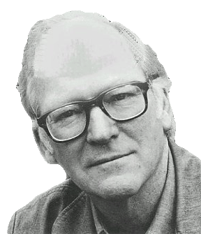
“We are stuck with our two main ways of describing and explaining things, one which treats objects and events as mindless, and the other which treats objects and events as having propositional attitudes. I see no way of bridging the gap”
(Davidson 2003: 697)

Slide 23
“We are stuck with our two main ways of describing and explaining things, one which treats objects and events as mindless, and the other which treats objects and events as having propositional attitudes. I see no way of bridging the gap”
(Davidson 2003: 697)

Slide 24
Propositional attitude
Relational attitude

Slide 25
Propositional attitude
Relational attitude
e.g. believes that ... e.g. intends that ... e.g. knows that ...
e.g. excited by ... e.g. encountered ... e.g. wants apple juice

Slide 26
Propositional attitude
Relational attitude
e.g. believes that ... e.g. intends that ... e.g. knows that ...
e.g. excited by ... e.g. encountered ... e.g. wants apple juice
arbitrarily nestable contents
no contents
uncodifiably complex effects on action
parameter-setting effects on action
permit mistakes about identity and existence
enable tracking limited range of true and false beliefs
Wellman & Phillips 2001 Apperly & Butterfill 2009

Slide 27
challenge
Explain the emergence, in evolution or development, of sophisticated forms of theory of mind cognition.
conjecture
The existence of abilities to engage in joint action partially explains how sophisticated forms of theory of mind cognition emerge in evolution or development (or both)
first objection
Sophisticated theory of mind cognition emerges before joint action

Slide 28
minimal theory of mind cognition
joint action (ability to share goals)
[other stuff]
sophisticated theory of mind cognition

Slide 29
challenge
Explain the emergence, in evolution or development, of sophisticated forms of theory of mind cognition.
conjecture
The existence of abilities to engage in joint action partially explains how sophisticated forms of theory of mind cognition emerge in evolution or development (or both)

Slide 30
challenge
Explain the emergence, in evolution or development, of sophisticated forms of theory of mind cognition.
conjecture
The existence of abilities to engage in joint action partially explains how sophisticated forms of theory of mind cognition emerge in evolution or development (or both)
2nd objection
Joint action presupposes sophisticated theory of mind cognition

Slide 31
shared intention

Slide 32
‘I take a collective action to involve a collective [shared] intention.’ (Gilbert 2006, p. 5)

Slide 33
‘I take a collective action to involve a collective [shared] intention.’ (Gilbert 2006, p. 5)
‘The sine qua non of collaborative action is a joint goal [shared intention] and a joint commitment’
(Tomasello 2008, p. 181)

Slide 34
‘I take a collective action to involve a collective [shared] intention.’ (Gilbert 2006, p. 5)
‘The sine qua non of collaborative action is a joint goal [shared intention] and a joint commitment’
(Tomasello 2008, p. 181)
‘the key property of joint action lies in its internal component [...] in the participants’ having a “collective” or “shared” intention.’
(Alonso 2009, pp. 444-5)
‘Shared intentionality is the foundation upon which joint action is built.’ (Carpenter 2009, p. 381)
“the partners ... have to be aware that they are pursuing a joint goal, which both jointly intend”
(Wareneken, Graefenhain & Tomasello 2011)

Slide 35
What is shared intention?

Slide 36

What is shared intention?

Slide 37
What is shared intention?
Functional characterisation
Substantial account

Slide 38
What is shared intention?
Functional characterisation
shared intention serves to (a) coordinate activities, (b) coordinate planning and (c) structure bargaining
Substantial account

Slide 39
What is shared intention?
Functional characterisation
shared intention serves to (a) coordinate activities, (b) coordinate planning and (c) structure bargaining
Substantial account
We have a shared intention that we J if
“1. (a) I intend that we J and (b) you intend that we J
“2. I intend that we J in accordance with and because of la, lb, and meshing subplans of la and lb; you intend [likewise] …
“3. 1 and 2 are common knowledge between us”
(Bratman 1993: View 4)

Slide 40
What is shared intention?
Functional characterisation
shared intention serves to (a) coordinate activities, (b) coordinate planning and (c) structure bargaining
Substantial account
We have a shared intention that we J if
“1. (a) I intend that we J and (b) you intend that we J
“2. I intend that we J in accordance with and because of la, lb, and meshing subplans of la and lb; you intend [likewise] …
“3. 1 and 2 are common knowledge between us”
(Bratman 1993: View 4)
{
Intentions about intentions

Slide 41
What is shared intention?
Functional characterisation
shared intention serves to (a) coordinate activities, (b) coordinate planning and (c) structure bargaining
Substantial account
We have a shared intention that we J if
“1. (a) I intend that we J and (b) you intend that we J
“2. I intend that we J in accordance with and because of la, lb, and meshing subplans of la and lb; you intend [likewise] …
“3. 1 and 2 are common knowledge between us”
(Bratman 1993: View 4)
{
Intentions about intentions
{
Knowledge of others’ knowledge of intentions about intentions

Slide 42
What is shared intention?
Functional characterisation
shared intention serves to (a) coordinate activities, (b) coordinate planning and (c) structure bargaining
Substantial account
We have a shared intention that we J if
“1. (a) I intend that we J and (b) you intend that we J
“2. I intend that we J in accordance with and because of la, lb, and meshing subplans of la and lb; you intend [likewise] …
“3. 1 and 2 are common knowledge between us”
(Bratman 1993: View 4)
{
Intentions about intentions
{
Knowledge of others’ knowledge of intentions about intentions

Slide 43
What is shared intention?
Functional characterisation
shared intention serves to (a) coordinate activities, (b) coordinate planning and (c) structure bargaining
Substantial account
We have a shared intention that we J if
“1. (a) I intend that we J and (b) you intend that we J
“2. I intend that we J in accordance with and because of la, lb, and meshing subplans of la and lb; you intend [likewise] …
“3. 1 and 2 are common knowledge between us”
(Bratman 1993: View 4)

Slide 44
What is shared intention?
Functional characterisation
shared intention serves to (a) coordinate activities, (b) coordinate planning and (c) structure bargaining
Substantial account
We have a shared intention that we J if
“1. (a) I intend that we J and (b) you intend that we J
“2. I intend that we J in accordance with and because of la, lb, and meshing subplans of la and lb; you intend [likewise] …
“3. 1 and 2 are common knowledge between us”
(Bratman 1993: View 4)
‘shared intentional agency consists, at bottom, in interconnected planning agency of the participants.’
(Bratman 2011, p. 11)

Slide 45
1. All (significant) joint actions require shared intention.
2. Shared intention requires sophisticated theory of mind cognition.
Therefore:
3. Abilities to engage in joint action could play no significant role in explaining how sophisticated theory of mind cognition emerges.

Slide 46
1. All (significant) joint actions require shared intention.
2. Shared intention requires sophisticated theory of mind cognition.
Therefore:
3. Abilities to engage in joint action could play no significant role in explaining how sophisticated theory of mind cognition emerges.
(not why)

Slide 47
1. All (significant) joint actions require shared intention.
2. Shared intention requires sophisticated theory of mind cognition.
Therefore:
3. Abilities to engage in joint action could play no significant role in explaining how sophisticated theory of mind cognition emerges.

Slide 48
1. All (significant) joint actions require shared intention.
2. Shared intention requires sophisticated theory of mind cognition.
Therefore:
3. Abilities to engage in joint action could play no significant role in explaining how sophisticated theory of mind cognition emerges.

Slide 49
Goal-directed joint action: an event with two or more agents which, taken as a whole, is directed to a goal.

Slide 50
Goal-directed joint action: an event with two or more agents which, taken as a whole, is directed to a goal.

Slide 51
Goal-directed joint action: an event with two or more agents which, taken as a whole, is directed to a goal.
out
out
act
out
act
out

Slide 52
Goal-directed joint action: an event with two or more agents which, taken as a whole, is directed to a goal.
out
out
act
represents
coordinates
out
act
shared intention
out

Slide 53
Goal-directed joint action: an event with two or more agents which, taken as a whole, is directed to a goal.
???
out
out
act
represents
coordinates
out
act
shared intention
out

Slide 54
Detour
Goals are not intentions

Slide 55
What is the relation between an action and the goal (or goals) to which it is directed?
out
out
act
out
out

Slide 56
What is the relation between an action and the goal (or goals) to which it is directed?
out
out
act
out
out

Slide 57
What is the relation between an action and the goal (or goals) to which it is directed?
out
out
act
out
intention or other goal-state
out

Slide 58
What is the relation between an action and the goal (or goals) to which it is directed?
teleological function
out
out
act
out
intention or other goal-state
out

Slide 59
(i) in the past, actions of this type have caused outcomes of this type; (ii) this action happens now in part because (i).
What is the relation between an action and the goal (or goals) to which it is directed?
teleological function
out
out
act
out
intention or other goal-state
out

Slide 60
(i) in the past, actions of this type have caused outcomes of this type; (ii) this action happens now in part because (i).
What is the relation between an action and the goal (or goals) to which it is directed?
teleological function
out
out
act
out
intention or other goal-state
It is possible to represent goal-directed actions without representing intentions.
out

Slide 61
End Detour

Slide 62
Goal-directed joint action: an event with two or more agents which, taken as a whole, is directed to a goal.
???
out
out
act
represents
coordinates
out
act
shared intention
out

Slide 63
Goal-directed joint action: an event with two or more agents which, taken as a whole, is directed to a goal.
G is a distributive goal: it is an outcome to which each agent’s actions are individually directed and it is possible that: all actions succeed relative to this outcome.

Slide 64
Goal-directed joint action: an event with two or more agents which, taken as a whole, is directed to a goal.
G is a distributive goal: it is an outcome to which each agent’s actions are individually directed and it is possible that: all actions succeed relative to this outcome.
“we need a principled way of distinguishing genuine joint actions from mere joint happenings or joint doings.”
(Pacherie 2011, 175)

Slide 65
Goal-directed joint action: an event with two or more agents which, taken as a whole, is directed to a goal.
G is a distributive goal: it is an outcome to which each agent’s actions are individually directed and it is possible that: all actions succeed relative to this outcome.
“we need a principled way of distinguishing genuine joint actions from mere joint happenings or joint doings.”
(Pacherie 2011, 175)

Slide 66
Joint
Not joint

Slide 67
Joint
Not joint
Jack and Sue walk together
Jack and Sue walk alongside each other
(Gilbert 1990)

Slide 68
Joint
Not joint
Jack and Sue walk together
Jack and Sue walk alongside each other
(Gilbert 1990)
We collectively perform a dance by running to a shelter at the same time
We each individually run to a shelter at the same time (in response to a sudden shower).
(Searle 1990, 92)

Slide 69
Goal-directed joint action: an event with two or more agents which, taken as a whole, is directed to a goal.
G is a distributive goal: it is an outcome to which each agent’s actions are individually directed and it is possible that: all actions succeed relative to this outcome.
“we need a principled way of distinguishing genuine joint actions from mere joint happenings or joint doings.”
(Pacherie 2011, 175)

Slide 70
Goal-directed joint action: an event with two or more agents which, taken as a whole, is directed to a goal.
G is a distributive goal: it is an outcome to which each agent’s actions are individually directed and it is possible that: all actions succeed relative to this outcome.
Nora’s shooting
“we need a principled way of distinguishing genuine joint actions from mere joint happenings or joint doings.”
(Pacherie 2011, 175)
Fred’s death
Olive’s shooting
Fred’s killing

Slide 71
Goal-directed joint action: an event with two or more agents which, taken as a whole, is directed to a goal.
G is a distributive goal: it is an outcome to which each agent’s actions are individually directed and it is possible that: all actions succeed relative to this outcome.
G is a collective goal
(a) it is a distributive goal;
(b) the actions are coordinated; and
(c) coordination of this type would normally facilitate occurrences of outcomes of this type.
“we need a principled way of distinguishing genuine joint actions from mere joint happenings or joint doings.”
(Pacherie 2011, 175)

Slide 72
Goal-directed joint action: an event with two or more agents which, taken as a whole, is directed to a goal.
G is a distributive goal: it is an outcome to which each agent’s actions are individually directed and it is possible that: all actions succeed relative to this outcome.
G is a collective goal
(a) it is a distributive goal;
(b) the actions are coordinated; and
(c) coordination of this type would normally facilitate occurrences of outcomes of this type.
“we need a principled way of distinguishing genuine joint actions from mere joint happenings or joint doings.”
(Pacherie 2011, 175)

Slide 73
Goal-directed joint action: an event with two or more agents which, taken as a whole, is directed to a goal.
“It ... seems useful to draw a distinction between elementary or thin forms of joint action common to humans and other social mammals and sophisticated or thick forms of joint action, perhaps unique to the human species.”
(Pacherie & Dokic 2006, 110)
G is a distributive goal: it is an outcome to which each agent’s actions are individually directed and it is possible that: all actions succeed relative to this outcome.
G is a collective goal
(a) it is a distributive goal;
(b) the actions are coordinated; and
(c) coordination of this type would normally facilitate occurrences of outcomes of this type.
“we need a principled way of distinguishing genuine joint actions from mere joint happenings or joint doings.”
(Pacherie 2011, 175)

Slide 74
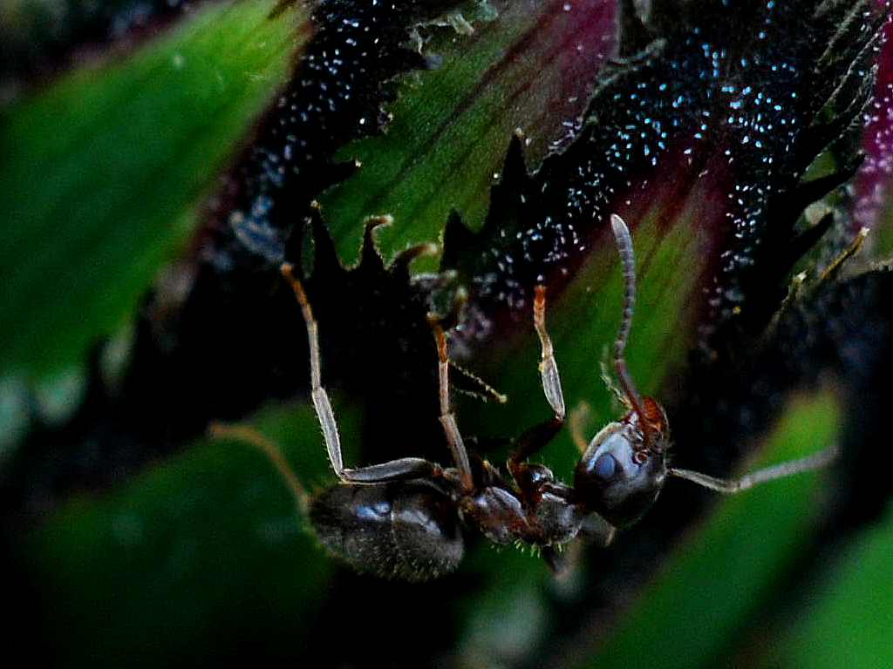

Slide 75
sting
sting
sting
sting
sting
death of fly
sting
sting
sting

Slide 76
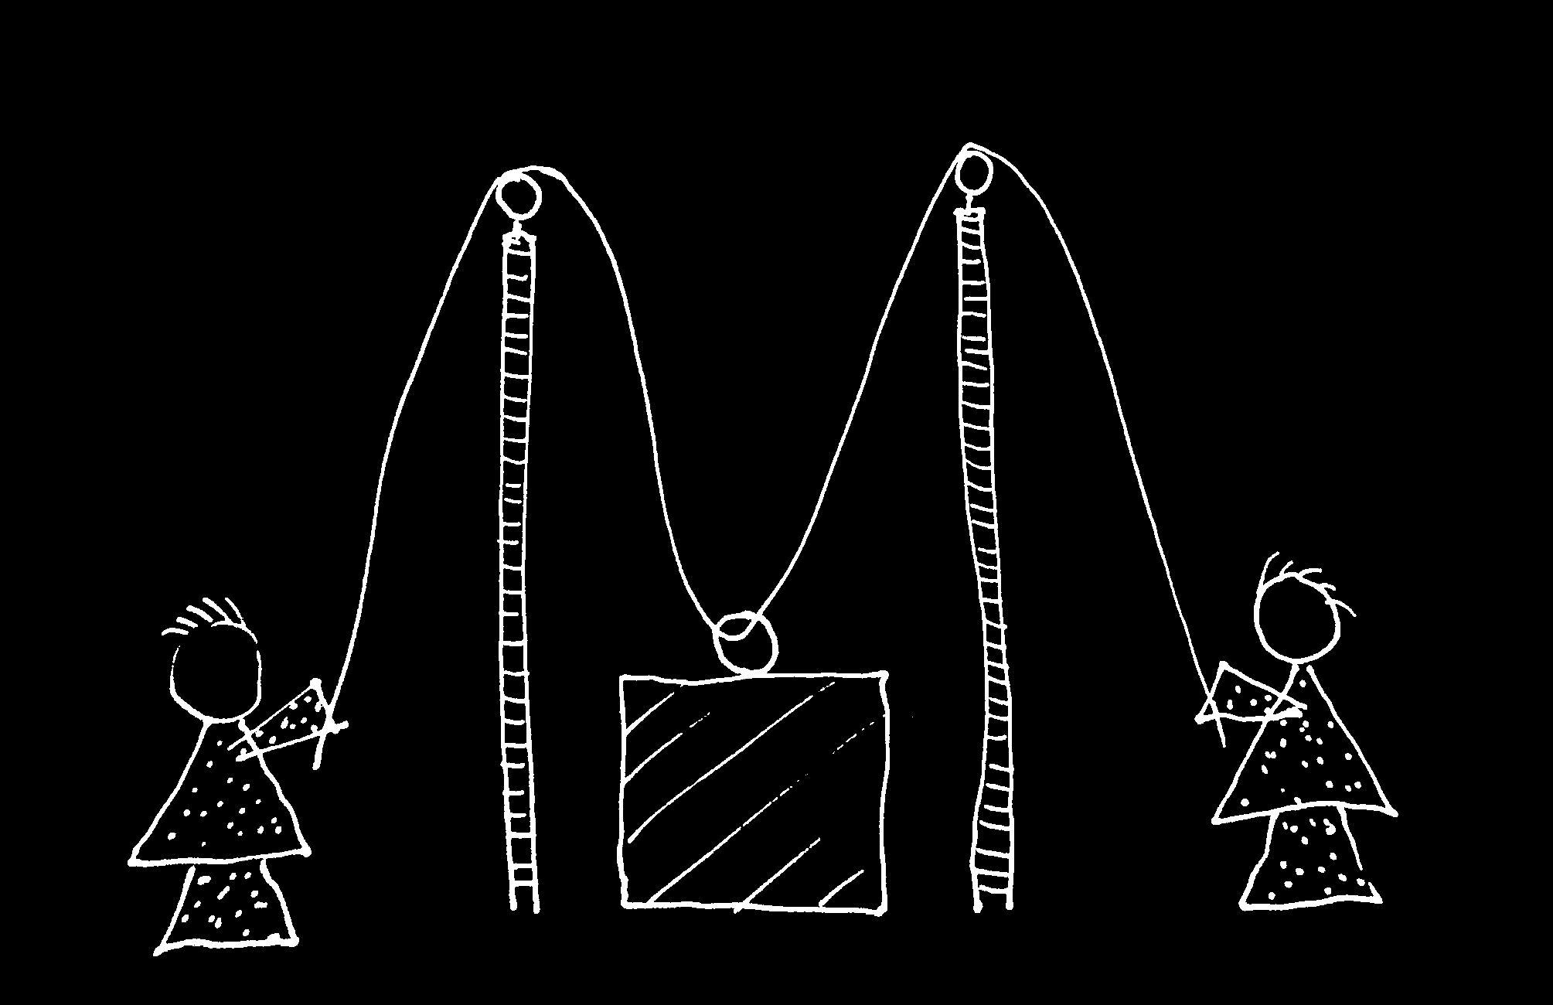

Slide 77
Goal-directed joint action: an event with two or more agents which, taken as a whole, is directed to a goal.
G is a distributive goal: it is an outcome to which each agent’s actions are individually directed and it is possible that: all actions succeed relative to this outcome.
G is a collective goal
(a) it is a distributive goal;
(b) the actions are coordinated; and
(c) coordination of this type would normally facilitate occurrences of outcomes of this type.

Slide 78
Goal-directed joint action: an event with two or more agents which, taken as a whole, is directed to a goal.
G is a distributive goal: it is an outcome to which each agent’s actions are individually directed and it is possible that: all actions succeed relative to this outcome.
G is a shared goal
G is a collective goal
(a) it is a distributive goal;
(b) the actions are coordinated; and
(c) coordination of this type would normally facilitate occurrences of outcomes of this type.
Each agent most wants and expects each of the other agents to perform activities directed to the goal.
Each agent most wants and expects the goal to occur as a common effect of all their goal-directed actions.

Slide 79
Goal-directed joint action: an event with two or more agents which, taken as a whole, is directed to a goal.
G is a distributive goal: it is an outcome to which each agent’s actions are individually directed and it is possible that: all actions succeed relative to this outcome.
G is a shared goal
G is a collective goal
(a) it is a distributive goal;
(b) the actions are coordinated; and
(c) coordination of this type would normally facilitate occurrences of outcomes of this type.
Each agent most wants and expects each of the other agents to perform activities directed to the goal.
Each agent most wants and expects the goal to occur as a common effect of all their goal-directed actions.

Slide 80
Goal-directed joint action: an event with two or more agents which, taken as a whole, is directed to a goal.
G is a distributive goal: it is an outcome to which each agent’s actions are individually directed and it is possible that: all actions succeed relative to this outcome.
G is a shared goal
G is a collective goal
(a) it is a distributive goal;
(b) the actions are coordinated; and
(c) coordination of this type would normally facilitate occurrences of outcomes of this type.
Each agent most wants and expects each of the other agents to perform activities directed to the goal.
Each agent most wants and expects the goal to occur as a common effect of all their goal-directed actions.

Slide 81
Goal-directed joint action: an event with two or more agents which, taken as a whole, is directed to a goal.
G is a distributive goal: it is an outcome to which each agent’s actions are individually directed and it is possible that: all actions succeed relative to this outcome.
G is a shared goal
G is a collective goal
(a) it is a distributive goal;
(b) the actions are coordinated; and
(c) coordination of this type would normally facilitate occurrences of outcomes of this type.
Each agent most wants and expects each of the other agents to perform activities directed to the goal.
Each agent most wants and expects the goal to occur as a common effect of all their goal-directed actions.

Slide 82
Goal-directed joint action: an event with two or more agents which, taken as a whole, is directed to a goal.
etc ...
G is a distributive goal: it is an outcome to which each agent’s actions are individually directed and it is possible that: all actions succeed relative to this outcome.
G is a shared goal
G is a collective goal
(a) it is a distributive goal;
(b) the actions are coordinated; and
(c) coordination of this type would normally facilitate occurrences of outcomes of this type.
Each agent most wants and expects each of the other agents to perform activities directed to the goal.
Each agent most wants and expects the goal to occur as a common effect of all their goal-directed actions.

Slide 83
challenge
Explain the emergence, in evolution or development, of sophisticated forms of theory of mind cognition.
conjecture
The existence of abilities to engage in joint action partially explains how sophisticated forms of theory of mind cognition emerge in evolution or development (or both)
2nd objection
Joint action presupposes sophisticated theory of mind cognition

Slide 84
challenge
Explain the emergence, in evolution or development, of sophisticated forms of theory of mind cognition.
conjecture
The existence of abilities to engage in joint action partially explains how sophisticated forms of theory of mind cognition emerge in evolution or development (or both)
2nd objection
Joint action presupposes sophisticated theory of mind cognition

Slide 85
challenge
Explain the emergence, in evolution or development, of sophisticated forms of theory of mind cognition.
conjecture
The existence of abilities to engage in joint action partially explains how sophisticated forms of theory of mind cognition emerge in evolution or development (or both)

Slide 86
challenge
Explain the emergence, in evolution or development, of sophisticated forms of theory of mind cognition.
conjecture
The existence of abilities to engage in joint action partially explains how sophisticated forms of theory of mind cognition emerge in evolution or development (or both)
3rd objection
But how does could it work?

Slide 87
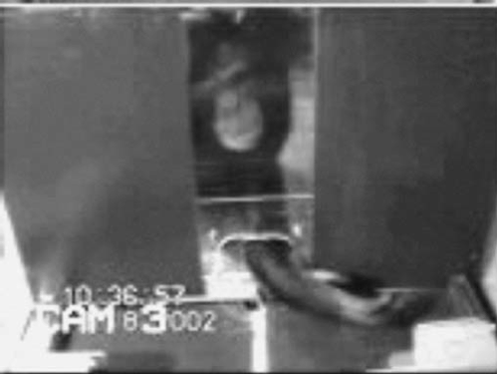

failed reach
point
source: Hare & Tomasello (2004)
Notes:
this illustrates problem of identifying particular goals of action

Slide 88
The problem of opaque means

Slide 89
The problem of false belief

Slide 90
your-goal-is-my-goal

Slide 91
your-goal-is-my-goal
1. We are about to engage in some joint action* or other
2. I am not about to change my goal.
Therefore:
3. Your actions also will be directed to this goal.
[*in at least the minimal sense associated with distributive goals]

Slide 92
failed reach
point
source: Hare & Tomasello (2004)

Slide 93
failed reach
point
source: Hare & Tomasello (2004)
“to understand pointing, the subject needs to understand more than the individual goal-directed behaviour. She needs to understand that ... the other attempts to communicate to her ... and ... the communicative intention behind the gesture”
(Moll & Tomsello 2007)

Slide 94
failed reach
point
source: Hare & Tomasello (2004)
“to understand pointing, the subject needs to understand more than the individual goal-directed behaviour. She needs to understand that ... the other attempts to communicate to her ... and ... the communicative intention behind the gesture”
(Moll & Tomsello 2007)

Slide 95
challenge
Explain the emergence, in evolution or development, of sophisticated forms of theory of mind cognition.
conjecture
The existence of abilities to engage in joint action partially explains how sophisticated forms of theory of mind cognition emerge in evolution or development (or both)
3rd objection
But how does could it work?

Slide 96

minimal theory of mind cognition
joint action (ability to share goals)
understanding communicative intent
other stuff
communication by language
other stuff
sophisticated theory of mind cognition

